Slide 1



LOAN APPROVAL ANALYSIS

Slide 2
TABLE OF CONTENTS
01
02
03
04
05
06
BUSINESS OVERVIEW
PROBLEM STATEMENT
OBJECTIVES
DATA UNDERSTANDING
DATA ANALYSIS
BUSINESS UNDERSTANDING

Slide 3

In the project, we will be working on loan approval analysis for stakeholders in the financial sector. The stakeholder is the financial institutions, and loan borrowers, who are in the business of loans. Borrowers can use this information to improve their credit worthiness to help them access loans. Financial Institutions can use the information to identify factors that can help them pick out credit worthy applicants. helps prospective homeowners
OVERVIEW

Slide 4
Financial Institutions Credit Applicants Investors Entrepreneurs
TARGET AUDIENCE

Slide 5
2.2 PROBLEM STATEMENT
This project aims to address the challenge of identifying the key factors influencing loan approvals by conducting an in-depth analysis of a dataset containing loan approval variables. Through this analysis, we seek to uncover patterns, trends, and relationships among the following variables: loan amount, loan status, cibil score, income amount, assets value amongst others.

Slide 6
2.1 OBJECTIVES
To examine the relationship between the loan status and its features, like loan term, income amount of the applicant, cibil score amongst others.
To identify the factors that influence loan approvals and to develop a predictive model based on the features of the loan.
To evaluate the impact of loan amount on the loan status and to determine the optimal
To discover insights of how loans are approved
To increase the chances of credit worthy applicants getting their loans approved

Slide 7
03. BUSINESS UNDERSTANDING
The loan process begins with a borrower submitting an application to a lender, providing necessary documentation such as income details and credit history. The lender reviews the application, assesses the borrower's creditworthiness, and conducts underwriting to determine the risk associated with the loan. If approved, the lender offers specific loan terms, and the borrower agrees to the terms by signing a loan agreement. The closing process involves finalizing the details, and once completed, the lender disburses the funds. The borrower then repays the loan through regular installments, covering both interest and principal. The process concludes when the borrower successfully completes the repayment, and any liens or claims on collateral are released. The loan process may vary based on the type of loan and lender policies. This analysis aims to find out the factors that influence a loan approval

Slide 8

03. DATA UNDERSTANDING
The loan approval dataset is a collection of financial records and associated information used to determine the eligibility of individuals or organizations for obtaining loans from a lending institution. It includes various factors such as cibil score, income, employment status, loan term, loan amount, assets value, and loan status. This dataset is commonly used in machine learning and data analysis to develop models and algorithms that predict the likelihood of loan approval based on the given features.

Slide 9
03. DATA FEATURES
Columns
no_of_dependents: Number of Dependents of the Applicant
education: Education of the Applicant (Graduate/Not Graduate)
self_employed: Employment Status of the Applicant
income_annum: Annual Income of the Applicant
loan_amount: Loan Amount
loan_term: Loan Term in Years
cibil_score: Credit Score
residential_assets_valuetotal value of residential properties owned by an individual
commercial_assets_value total value of commercial properties owned by individual
luxury_assets_value total value of high end assets owned by an individual
bank_asset_valuetotal value of assets held by a bank
loan status: Loan Approval Status (Approved/Rejected)

Slide 10


DATA ANALYSIS
The EDA in this project involved checking the dataset shape and info, descriptive statistics. Visualizing the impact of various features on the loan status. Categorical data was encoded and various feature selection techniques were used to identify the features highly correlated with the loan status

Slide 11
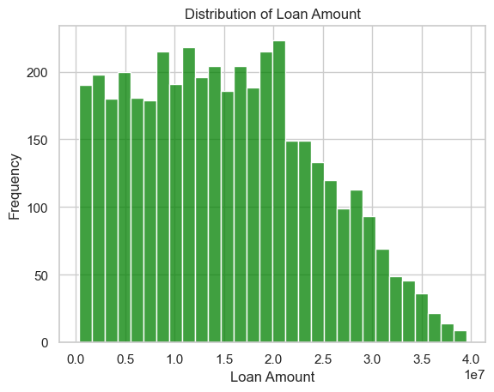
Loan Amount Distribution

Slide 12
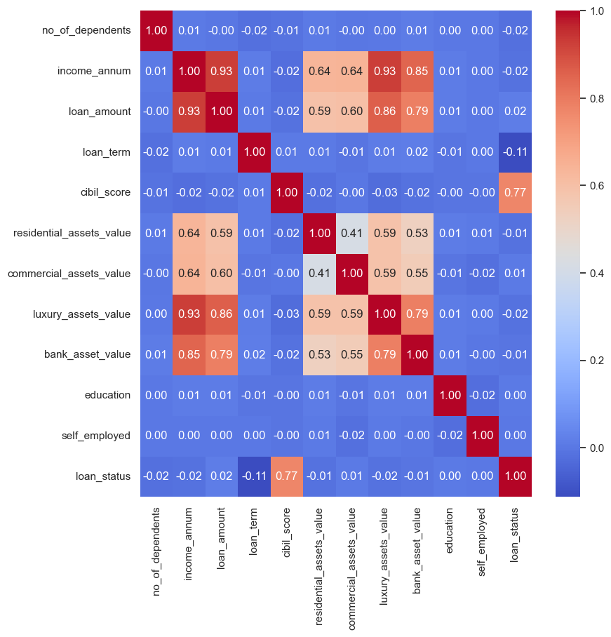
How Loan Status correlates with features

Slide 13
MODELING COMPARISONS
MODELING COMPARISON
MODEL | ACCURACY | PRECISION | RECALL | F1 SCORE
LOGISTIC REGRESSION | 0.906 | 0.924 | 0.927 | 0.926
RANDOM FOREST | 0.979 | 0.98 | 0.984 | 0.982
DECISION TREE | 0.973 | 0.971 | 0.984 | 0.978
SUPPORT VECTOR | 0.508 | 0.626 | 0.429 | 0.509
K-NEIGHBOR | 0.583 | 0.619 | 0.78 | 0.69

Slide 14
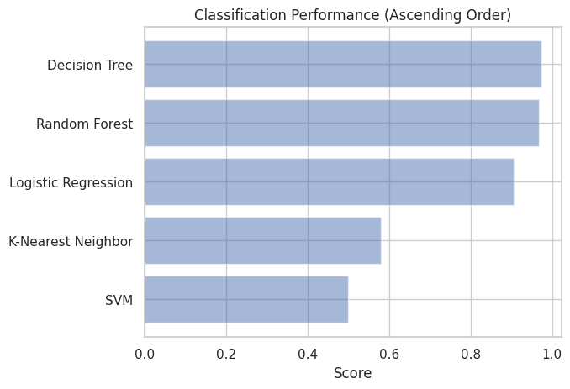
MODELING COMPARISONS

Slide 15
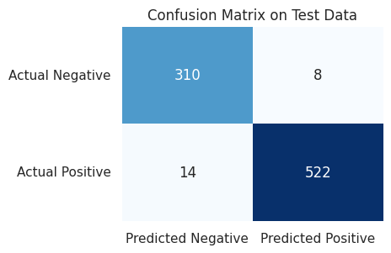
MODELING COMPARISONS

Slide 16
CONFUSION MATRIX EXPLANATION
The scores in the confusion matrix above mean:
True negatives (upper left): The number of applications that were rejected that the model accurately predicted were rejected.
False negatives (bottom left): The number of applications that were approved that the model inaccurately predicted were rejected.
False positives (upper right): The number of applications that were rejected that the model inaccurately predicted were approved.
True positives (bottom right): The number of applications that were approved that the model accurately predicted were approved.

Slide 17
Our analysis revealed several important insights: i.) Loan Amount and Annual Income: We found a strong positive correlation between loan amount and annual income. As expected, individuals with higher annual incomes were more likely to secure larger loan amounts. This underscores the importance of a borrower's financial capacity in determining loan approval. ii.)Loan Term and Approval Rate: Shorter loan terms, particularly 2 and 4 years, exhibited higher approval rates compared to longer terms. This suggests that borrowers opting for shorter loan durations are perceived as lower risk by lenders. Iii.) Asset Values and Income: Luxury asset values and bank asset values demonstrated stronger positive correlations with annual income compared to residential and commercial asset values. This suggests that higher-income individuals are more likely to possess luxury items and maintain larger bank assets. Iv.)Categorical Variables: Our ANOVA tests examined the relationships between categorical variables (no_of_dependents, education, self_employed) and loan amount. While some variables showed minor effects on loan amount, none exhibited statistically significant relationships. V.) Machine Learning model: We used Random Forest model, which has ability to handle non-linearity, interactions between variables, and potential outliers, correctly predicted approximately 97% ~ 98% loan applications. This model allowed us to identify the most influential features in predicting loan approvals and made predictive performance remain reliable across various scenarios. While the model performs well, there's always room for improvement by gathering more data, refine features, and fine-tune model parameters to enhance predictive accuracy further. C
CONCLUSIONS

Slide 18
NEXT STEPS
In light of these findings, it's clear that loan approval decisions are driven by a combination of financial factors, including income, loan amount, and loan term. While certain categorical variables appeared to have limited impact on loan amount, the overall focus should remain on financial indicators.
It's important to note that our analysis is subject to certain limitations. The dataset may not capture all relevant factors affecting loan approval, and outliers or data inaccuracies could influence results. Additionally, causation cannot be established through correlation alone.
Moving forward, this analysis provides valuable insights for lenders and borrowers alike. Lenders can use these findings to refine their loan approval criteria, while borrowers can better understand the factors influencing their chances of approval.
Suggestion:
Further research could delve deeper into qualitative aspects such as loan purpose, borrower credit history, and economic conditions. Additionally, considering a wider range of features and employing advanced machine learning techniques could provide a more nuanced understanding of loan approval dynamics.
In conclusion, this analysis sheds light on the intricate relationships between various factors and loan approval outcomes. The insights gained can guide data-driven decision-making in the lending industry.

Slide 19
THANKS!!

